Slide 1
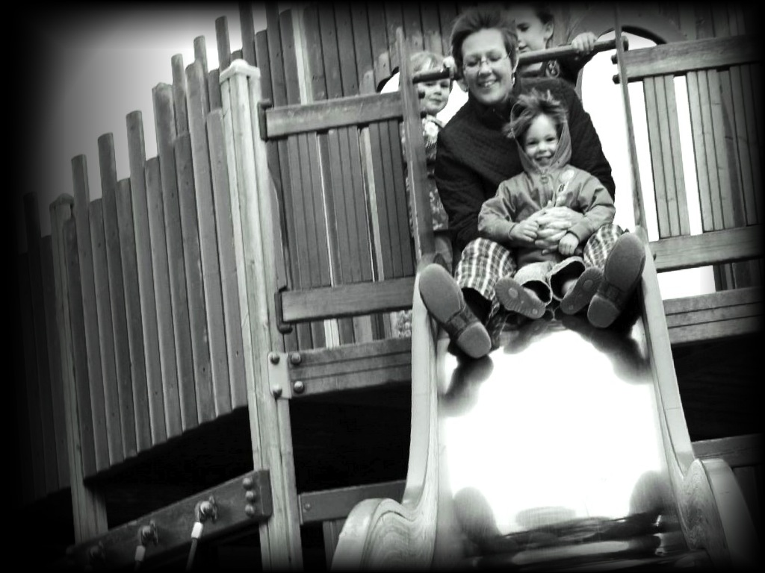
&
Minimal
Theory of Mind
Joint Action
s.butterfill@warwick.ac.uk

Slide 2
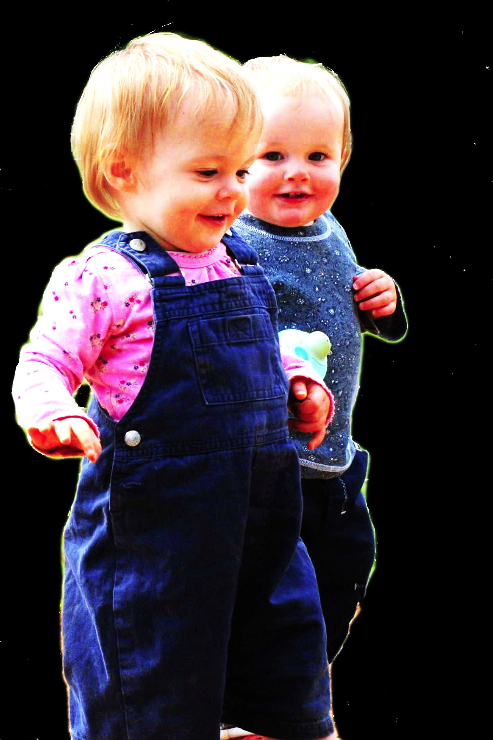
challenge
Explain the emergence, in evolution or development, of full-blown theory of mind cognition.

Slide 3
challenge
Explain the emergence, in evolution or development, of full-blown theory of mind cognition.
assumption
We need to understand how theory of mind cognition could come in degrees.

Slide 4


“chimpanzees understand … intentions … perception and knowledge … Moreover, they understand how these psychological states work together to produce intentional action”
(Call & Tomasello 2008:191)

Slide 5
“chimpanzees understand … intentions … perception and knowledge … Moreover, they understand how these psychological states work together to produce intentional action”
(Call & Tomasello 2008:191)
“chimpanzees probably do not understand others in terms of a fully human-like belief–desire psychology”
(Call and Tomasello 2008)

Slide 6
challenge
Explain the emergence, in evolution or development, of full-blown theory of mind cognition.
assumption
We need to understand how theory of mind cognition could come in degrees.

Slide 7
“chimpanzees understand … intentions … perception and knowledge … Moreover, they understand how these psychological states work together to produce intentional action”
(Call & Tomasello 2008:191)
“chimpanzees probably do not understand others in terms of a fully human-like belief–desire psychology”
(Call and Tomasello 2008)

Slide 8
“chimpanzees understand … intentions … perception and knowledge … Moreover, they understand how these psychological states work together to produce intentional action”
(Call & Tomasello 2008:191)
“chimpanzees probably do not understand others in terms of a fully human-like belief–desire psychology”
(Call and Tomasello 2008)

Slide 9
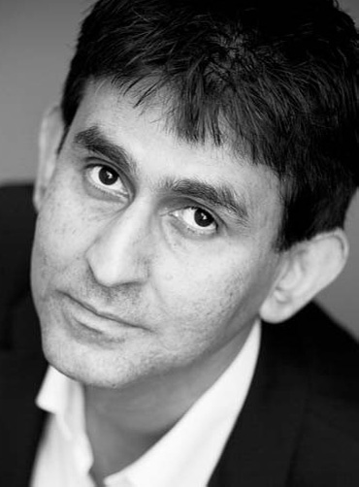
“chimpanzees understand … intentions … perception and knowledge … Moreover, they understand how these psychological states work together to produce intentional action”
(Call & Tomasello 2008:191)
“our [typical adult humans’] fundamental conception of what it is to know that P is itself an explanatory conception […] we think of S’s knowledge that P as something that can properly be explained by reference to what S has perceived or remembered or proved or ...”
(Cassam 2007: 356)

Slide 10
challenge
Explain the emergence, in evolution or development, of full-blown theory of mind cognition.
assumption
We need to understand how theory of mind cognition could come in degrees.

Slide 11
puzzle

Slide 12
Theory of mind abilities are widespread
18-month-olds point to inform, and predict actions based on false beliefs
(Liszkowski et al 2006)
(Onishi & Baillargeon 2005; Southgate et al 2007)

Slide 13
Theory of mind abilities are widespread
18-month-olds point to inform, and predict actions based on false beliefs
Scrub-jays selectively re-cache their food in ways that deprive competitors of knowledge of its location
(Liszkowski et al 2006)
(Onishi & Baillargeon 2005; Southgate et al 2007)
(Clayton, Dally & Emery 2007)

Slide 14
Theory of mind abilities are widespread
18-month-olds point to inform, and predict actions based on false beliefs
Scrub-jays selectively re-cache their food in ways that deprive competitors of knowledge of its location
Chimpanzees conceal their approach from a competitor’s view, and act in ways that are optimal given what another has seen
(Liszkowski et al 2006)
(Onishi & Baillargeon 2005; Southgate et al 2007)
(Clayton, Dally & Emery 2007)
(Hare, Call & Tomasello 2006)
(Hare, Call & Tomasello 2001)

Slide 15
Theory of mind abilities are widespread
18-month-olds point to inform, and predict actions based on false beliefs
Scrub-jays selectively re-cache their food in ways that deprive competitors of knowledge of its location
Chimpanzees conceal their approach from a competitor’s view, and act in ways that are optimal given what another has seen
(Liszkowski et al 2006)
(Onishi & Baillargeon 2005; Southgate et al 2007)
(Clayton, Dally & Emery 2007)
(Hare, Call & Tomasello 2006)
(Hare, Call & Tomasello 2001)

Slide 16
Theory of mind abilities are widespread
18-month-olds point to inform, and predict actions based on false beliefs
Scrub-jays selectively re-cache their food in ways that deprive competitors of knowledge of its location
Chimpanzees conceal their approach from a competitor’s view, and act in ways that are optimal given what another has seen
(Liszkowski et al 2006)
(Onishi & Baillargeon 2005; Southgate et al 2007)
(Clayton, Dally & Emery 2007)
(Hare, Call & Tomasello 2006)
(Hare, Call & Tomasello 2001)

Slide 17
Theory of mind abilities are widespread
18-month-olds point to inform, and predict actions based on false beliefs
Scrub-jays selectively re-cache their food in ways that deprive competitors of knowledge of its location
Chimpanzees conceal their approach from a competitor’s view, and act in ways that are optimal given what another has seen
Representing perceptions, knowledge states and beliefs is hard

Slide 18
Theory of mind abilities are widespread
18-month-olds point to inform, and predict actions based on false beliefs
Scrub-jays selectively re-cache their food in ways that deprive competitors of knowledge of its location
Chimpanzees conceal their approach from a competitor’s view, and act in ways that are optimal given what another has seen
Representing perceptions, knowledge states and beliefs is hard, for it requires
(a) conceptual sophistication
- takes years to develop
- development tied to acquisition of executive function and language
- development facilitated by training and siblings

Slide 19
Theory of mind abilities are widespread
18-month-olds point to inform, and predict actions based on false beliefs
Scrub-jays selectively re-cache their food in ways that deprive competitors of knowledge of its location
Chimpanzees conceal their approach from a competitor’s view, and act in ways that are optimal given what another has seen
Representing perceptions, knowledge states and beliefs is hard, for it requires
(a) conceptual sophistication
- takes years to develop
- development tied to acquisition of executive function and language
- development facilitated by training and siblings
(b) scarce cognitive resources
- attention
- working memory

Slide 20
Theory of mind abilities are widespread
18-month-olds point to inform, and predict actions based on false beliefs
Scrub-jays selectively re-cache their food in ways that deprive competitors of knowledge of its location
Chimpanzees conceal their approach from a competitor’s view, and act in ways that are optimal given what another has seen
Representing perceptions, knowledge states and beliefs is hard, for it requires
(a) conceptual sophistication
- takes years to develop
- development tied to acquisition of executive function and language
- development facilitated by training and siblings
(b) scarce cognitive resources
- attention
- working memory

Slide 21
puzzle
What could infants, chimps and scrub-jays represent that would enable them, within limits, to track others’ perceptions, knowledge, beliefs and other propositional attitudes?

Slide 22




puzzle
What could infants, chimps and scrub-jays represent that would enable them, within limits, to track others’ perceptions, knowledge, beliefs and other propositional attitudes?

Slide 23
Propositional attitude
Relational attitude

Slide 24
Propositional attitude
Relational attitude
e.g. believes that ... e.g. intends that ... e.g. knows that ...
e.g. excited by ... e.g. encountered ... e.g. wants apple juice

Slide 25
Propositional attitude
Relational attitude
e.g. believes that ... e.g. intends that ... e.g. knows that ...
e.g. excited by ... e.g. encountered ... e.g. wants apple juice
arbitrarily nestable contents
no contents
uncodifiably complex effects on action
parameter-setting effects on action
permit mistakes about identity and existence
enable tracking limited range of true and false beliefs
Wellman & Phillips 2001 Apperly & Butterfill 2009

Slide 26
challenge
Explain the emergence, in evolution or development, of full-blown theory of mind cognition.
puzzle
What could infants, chimps and scrub-jays represent that would enable them, within limits, to track others’ perceptions, knowledge, beliefs and other propositional attitudes?

Slide 27

challenge
Explain the emergence, in evolution or development, of full-blown theory of mind cognition.
puzzle
What could infants, chimps and scrub-jays represent that would enable them, within limits, to track others’ perceptions, knowledge, beliefs and other propositional attitudes?

Slide 28

Your field = a set of objects related to you by proximity, orientation, lighting and other factors
You encounter an object = it is in your field
You register an object at a location = you most recently encountered the object at that location

Slide 29
Your field = a set of objects related to you by proximity, orientation, lighting and other factors
You encounter an object = it is in your field
You register an object at a location = you most recently encountered the object at that location
proximity
orientation
lighting
barriers
trajectory

Slide 30
Your field = a set of objects related to you by proximity, orientation, lighting and other factors
You encounter an object = it is in your field
You register an object at a location = you most recently encountered the object at that location
proximity
orientation
lighting
barriers
trajectory

Slide 31
Detour
Goals are not intentions

Slide 32
What is the relation between an action and the goal (or goals) to which it is directed?
out
out
act
out
out

Slide 33
What is the relation between an action and the goal (or goals) to which it is directed?
out
out
act
out
out

Slide 34
What is the relation between an action and the goal (or goals) to which it is directed?
out
out
act
out
intention or other goal-state
out

Slide 35
What is the relation between an action and the goal (or goals) to which it is directed?
teleological function
out
out
act
out
intention or other goal-state
out

Slide 36
(i) in the past, actions of this type have caused outcomes of this type; (ii) this action happens now in part because (i).
What is the relation between an action and the goal (or goals) to which it is directed?
teleological function
out
out
act
out
intention or other goal-state
out

Slide 37
(i) in the past, actions of this type have caused outcomes of this type; (ii) this action happens now in part because (i).
What is the relation between an action and the goal (or goals) to which it is directed?
teleological function
out
out
act
out
intention or other goal-state
It is possible to represent goal-directed actions without representing intentions.
out

Slide 38
End Detour

Slide 39
Your field = a set of objects related to you by proximity, orientation, lighting and other factors
You encounter an object = it is in your field
You register an object at a location = you most recently encountered the object at that location
Principle 3: one can’t goal-directedly act on an object unless one has encountered it.
Principle 2: correct registration is a condition of successful action.
Principle 3: when an agent performs a goal-directed action and the goal specifies an object, the agent will act as if the object were actually in the location she registers it at.
proximity
orientation
lighting
barriers
trajectory

Slide 40
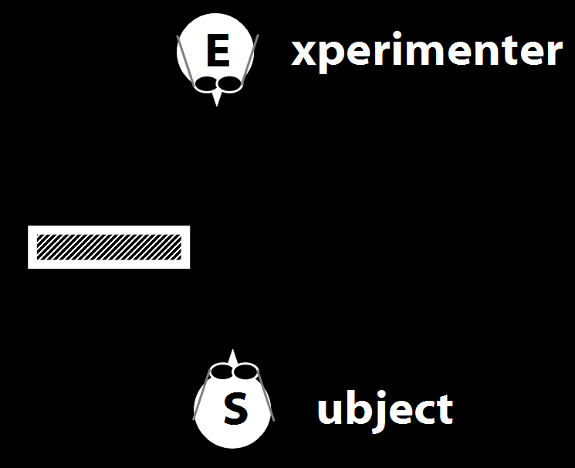
Your field = a set of objects related to you by proximity, orientation, lighting and other factors
You encounter an object = it is in your field
You register an object at a location = you most recently encountered the object at that location
Principle 3: one can’t goal-directedly act on an object unless one has encountered it.
Principle 2: correct registration is a condition of successful action.
Principle 3: when an agent performs a goal-directed action and the goal specifies an object, the agent will act as if the object were actually in the location she registers it at.
proximity
orientation
lighting
barriers
trajectory

Slide 41
Your field = a set of objects related to you by proximity, orientation, lighting and other factors
You encounter an object = it is in your field
You register an object at a location = you most recently encountered the object at that location
Principle 3: one can’t goal-directedly act on an object unless one has encountered it.
Principle 2: correct registration is a condition of successful action.
Principle 3: when an agent performs a goal-directed action and the goal specifies an object, the agent will act as if the object were actually in the location she registers it at.
“children could … think about what the other person saw rather than what they saw”
(Flavell, Shipstead & Croft 1978: 1210)
proximity
orientation
lighting
barriers
trajectory

Slide 42
Your field = a set of objects related to you by proximity, orientation, lighting and other factors
You encounter an object = it is in your field
You register an object at a location = you most recently encountered the object at that location
Principle 3: one can’t goal-directedly act on an object unless one has encountered it.
Principle 2: correct registration is a condition of successful action.
Principle 3: when an agent performs a goal-directed action and the goal specifies an object, the agent will act as if the object were actually in the location she registers it at.
“children could … think about what the other person saw rather than what they saw”
(Flavell, Shipstead & Croft 1978: 1210)
“children could … think about what the other person saw rather than what they saw”
(Flavell, Shipstead & Croft 1978: 1210)
proximity
orientation
lighting
barriers
trajectory

Slide 43
Your field = a set of objects related to you by proximity, orientation, lighting and other factors
You encounter an object = it is in your field
You register an object at a location = you most recently encountered the object at that location
Principle 3: one can’t goal-directedly act on an object unless one has encountered it.
Principle 2: correct registration is a condition of successful action.
Principle 3: when an agent performs a goal-directed action and the goal specifies an object, the agent will act as if the object were actually in the location she registers it at.
proximity
orientation
lighting
barriers
trajectory

Slide 44
Your field = a set of objects related to you by proximity, orientation, lighting and other factors
You encounter an object = it is in your field
You register an object at a location <= you most recently encountered the object at that location
Principle 3: one can’t goal-directedly act on an object unless one has encountered it.
Principle 2: correct registration is a condition of successful action.
Principle 3: when an agent performs a goal-directed action and the goal specifies an object, the agent will act as if the object were actually in the location she registers it at.
proximity
orientation
lighting
barriers
trajectory

Slide 45
Your field = a set of objects related to you by proximity, orientation, lighting and other factors
You encounter an object = it is in your field
You register an object at a location <= you most recently encountered the object at that location
Principle 3: one can’t goal-directedly act on an object unless one has encountered it.
Principle 4: correct registration is a condition of successful action.
Principle 3: when an agent performs a goal-directed action and the goal specifies an object, the agent will act as if the object were actually in the location she registers it at.
proximity
orientation
lighting
barriers
trajectory

Slide 46
source: Liszkowski et al (2008)

Slide 47
source: Liszkowski et al (2008)

Slide 48
source: Liszkowski et al (2008)

Slide 49
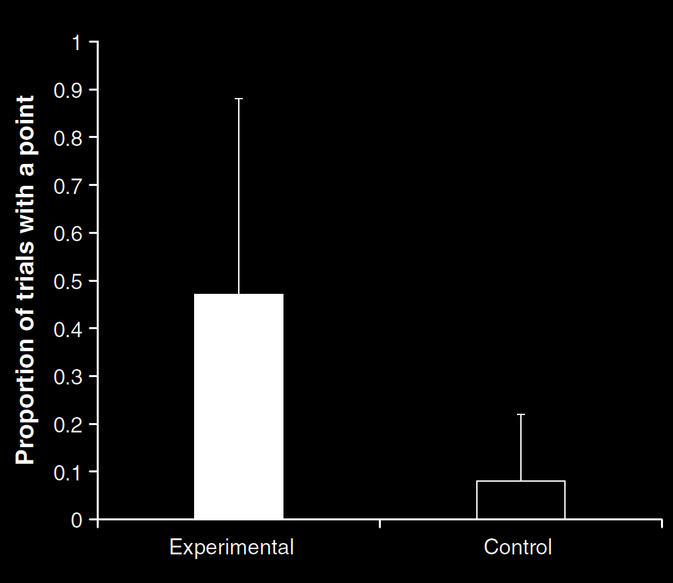
Your field = a set of objects related to you by proximity, orientation, lighting and other factors
You encounter an object = it is in your field
You register an object at a location <= you most recently encountered the object at that location
Principle 3: one can’t goal-directedly act on an object unless one has encountered it.
Principle 4: correct registration is a condition of successful action.
Principle 3: when an agent performs a goal-directed action and the goal specifies an object, the agent will act as if the object were actually in the location she registers it at.
source: Liszkowski et al (2008)
proximity
orientation
lighting
barriers
trajectory

Slide 50
source: Liszkowski et al (2008)

Slide 51
Your field = a set of objects related to you by proximity, orientation, lighting and other factors
You encounter an object = it is in your field
You register an object at a location <= you most recently encountered the object at that location
Principle 3: one can’t goal-directedly act on an object unless one has encountered it.
Principle 4: correct registration is a condition of successful action.
Principle 3: when an agent performs a goal-directed action and the goal specifies an object, the agent will act as if the object were actually in the location she registers it at.
source: Liszkowski et al (2008)
proximity
orientation
lighting
barriers
trajectory

Slide 52
Your field = a set of objects related to you by proximity, orientation, lighting and other factors
You encounter an object = it is in your field
You register an object at a location = you most recently encountered the object at that location
Principle 3: one can’t goal-directedly act on an object unless one has encountered it.
Principle 4: correct registration is a condition of successful action.
Principle 3: when an agent performs a goal-directed action and the goal specifies an object, the agent will act as if the object were actually in the location she registers it at.
“Helping by informing inextricably involves … an understanding of others’ goals and … of others’ ignorance.”
(Liszkowski, Carpenter & Tomasello 2008: 738-9)
source: Liszkowski et al (2008)
proximity
orientation
lighting
barriers
trajectory

Slide 53
Your field = a set of objects related to you by proximity, orientation, lighting and other factors
You encounter an object = it is in your field
You register an object at a location = you most recently encountered the object at that location
Principle 3: one can’t goal-directedly act on an object unless one has encountered it.
Principle 4: correct registration is a condition of successful action.
Principle 3: when an agent performs a goal-directed action and the goal specifies an object, the agent will act as if the object were actually in the location she registers it at.
“Helping by informing inextricably involves … an understanding of others’ goals and … of others’ ignorance.”
(Liszkowski, Carpenter & Tomasello 2008: 738-9)
“Helping by informing inextricably involves … an understanding of others’ goals and … of others’ ignorance.”
(Liszkowski, Carpenter & Tomasello 2008: 738-9)
source: Liszkowski et al (2008)
proximity
orientation
lighting
barriers
trajectory

Slide 54
Your field = a set of objects related to you by proximity, orientation, lighting and other factors
You encounter an object = it is in your field
You register an object at a location <= you most recently encountered the object at that location
Principle 3: one can’t goal-directedly act on an object unless one has encountered it.
Principle 4: correct registration is a condition of successful action.
Principle 3: when an agent performs a goal-directed action and the goal specifies an object, the agent will act as if the object were actually in the location she registers it at.
proximity
orientation
lighting
barriers
trajectory

Slide 55
Your field = a set of objects related to you by proximity, orientation, lighting and other factors
You encounter an object = it is in your field
You register an object at a location <= you most recently encountered the object at that location
Principle 3: one can’t goal-directedly act on an object unless one has encountered it.
Principle 4: correct registration is a condition of successful action.
Principle 5
proximity
orientation
lighting
barriers
trajectory

Slide 56
Your field = a set of objects related to you by proximity, orientation, lighting and other factors
You encounter an object = it is in your field
You register an object at a location <= you most recently encountered the object at that location
Principle 3: one can’t goal-directedly act on an object unless one has encountered it.
Principle 4: correct registration is a condition of successful action.
Principle 5: when an agent performs a goal-directed action and the goal specifies an object, the agent will act as if the object were actually in the location she registers it at.
proximity
orientation
lighting
barriers
trajectory

Slide 57
challenge
Explain the emergence, in evolution or development, of full-blown theory of mind cognition.
assumption
We need to understand how theory of mind cognition could come in degrees.

Slide 58
puzzle
What could infants, chimps and scrub-jays represent that would enable them, within limits, to track others’ perceptions, knowledge, beliefs and other propositional attitudes?

Slide 59
signature limits

Slide 60
1. Charly is Samantha
2. Mitch believes that Charly is in Baltimore
3. Mitch believes that Samantha is in Baltimore
(1) & (2) ⇒ (3)

Slide 61
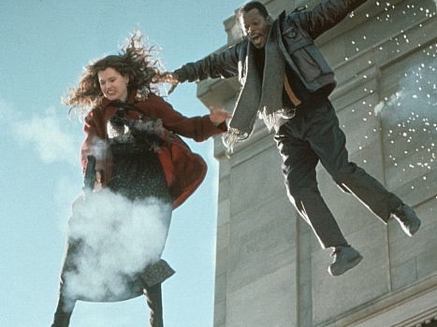
1. Charly is Samantha
2. Mitch believes that Charly is in Baltimore
3. Mitch believes that Samantha is in Baltimore
(1) & (2) ⇒ (3)

Slide 62
1. Charly is Samantha
2. Mitch believes that Charly is in Baltimore
3. Mitch believes that Samantha is in Baltimore
(1) & (2) ⇒ (3)
4. Mitch registers <Charly, Baltimore>
5. Mitch registers <Samantha, Baltimore>
(1) & (4) ⇒ (5)

Slide 63
False belief about location
False belief about identity
Subjects represent registration only
Subjects represent beliefs
pass
fail
pass
pass

Slide 64
Rubio, Richardson & Butterfill
Notes:
First introduce them to a sequence in three slides ... [large pictures so hopefully everyone can see what’s going on]
These are all from the subject’s point of view.
We’re going to start with what looks almost exactly like the test condition from a standard false belief task.
(1) The observer watches as his car disappears behind a barrier on your [audience’s] left

Slide 65
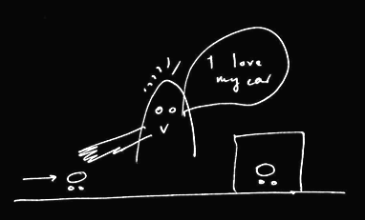
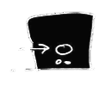
Rubio, Richardson & Butterfill
Notes:
First introduce them to a sequence in three slides ... [large pictures so hopefully everyone can see what’s going on]
These are all from the subject’s point of view.
We’re going to start with what looks almost exactly like the test condition from a standard false belief task.
(1) The observer watches as his car disappears behind a barrier on your [audience’s] left

Slide 66
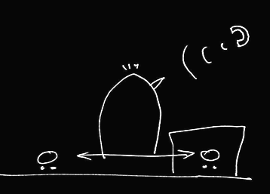

Rubio, Richardson & Butterfill
Notes:
(2) a telephone rings and the observer is distracted ... meanwhile the cars silently swap places (they’re electric cars, natch).

Slide 67
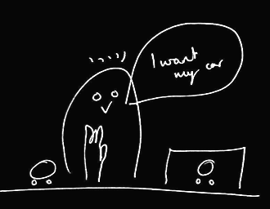
Rubio, Richardson & Butterfill
Notes:
(3) the observer comes back and wants to get her car (note the raised hand). Where do subjects look? They know that the observer’s car is actually behind the barrier. They are also in a position to know that the observer might not know this and might mistakenly think that his car is the one on subject’s LEFT.

Slide 68
her car is here
Rubio, Richardson & Butterfill
Notes:
(3) the observer comes back and wants to get her car (note the raised hand). Where do subjects look? They know that the observer’s car is actually behind the barrier. They are also in a position to know that the observer might not know this and might mistakenly think that his car is the one on subject’s LEFT.

Slide 69
she believes her car is here
her car is here
Rubio, Richardson & Butterfill
Notes:
(3) the observer comes back and wants to get her car (note the raised hand). Where do subjects look? They know that the observer’s car is actually behind the barrier. They are also in a position to know that the observer might not know this and might mistakenly think that his car is the one on subject’s LEFT.

Slide 70
she believes her car is here
her car is here
Rubio, Richardson & Butterfill
Notes:
(3) the observer comes back and wants to get her car (note the raised hand). Where do subjects look? They know that the observer’s car is actually behind the barrier. They are also in a position to know that the observer might not know this and might mistakenly think that his car is the one on subject’s LEFT.

Slide 71
we predict Ss will look here
she believes her car is here
her car is here
Rubio, Richardson & Butterfill
Notes:
(3) the observer comes back and wants to get her car (note the raised hand). Where do subjects look? They know that the observer’s car is actually behind the barrier. They are also in a position to know that the observer might not know this and might mistakenly think that his car is the one on subject’s LEFT.

Slide 72
Rubio, Richardson & Butterfill
Notes:
Here’s the whole sequence again, smaller.
If we were doing a standard false belief test, we could compare where people look in this sequence with where they look in another sequence in which the observer doesn’t turn away in the second scene.
If subjects can track false beliefs, we would expect them to be more likely to look towards SUBEJECTS-LEFT location in the depicted narrative than in the control version where the subject is not distracted by the telephone and so does not look away.
So this is almost a standard false belief task.
And like all standard false belief tasks, it requires tracking false beliefs about location only; it doesn’t require tracking false beliefs about registration.
Now consider a tiny variation ...

Slide 73
Rubio, Richardson & Butterfill
Notes:
... the middle vertical sequence is just like the right vertical sequence except that one of the barriers has been removed.
Now there are two ways of thinking about this.
On one way of thinking about it, there is no reason to think that the observer has a false belief because in the final scene (of the middle sequence) he’s looking right at a car which is not his own.
But if you think about this more carefully, that isn’t quite right because the car he’s looking at, although not his own, is visually indistinguishable from his own. So he might well believe, falsely, that his car on SUBJECTS-LEFT is actually his car.
So where subjects are capable of tracking false beliefs involving identity & where they realize that the cars are visually indistinguishable, they should be able to predict an incorrect reach.
But if subjects are not tracking about false beliefs about identity, then they will think that the observer will be able to retrieve his car from its actual location.

Slide 74
2
3
Rubio, Richardson & Butterfill
Notes:
... so let’s illustrate this with some graphs ...

Slide 75
2
3
belief: 2 ≈ 3
Rubio, Richardson & Butterfill
Notes:
... so let’s illustrate this with some graphs ...

Slide 76
2
3
belief: 2 ≈ 3
Rubio, Richardson & Butterfill
Notes:
... so let’s illustrate this with some graphs ...

Slide 77
2
3
left
right
left
right
belief: 2 ≈ 3
2
3
Rubio, Richardson & Butterfill
Notes:
... so let’s illustrate this with some graphs ...

Slide 78
2
3
left
right
left
right
belief: 2 ≈ 3
2
3
registration: 2 ≈ 3
Rubio, Richardson & Butterfill
Notes:
... so let’s illustrate this with some graphs ...

Slide 79
2
3
left
right
left
right
belief: 2 ≈ 3
2
3
registration: 2 ≈ 3
Rubio, Richardson & Butterfill
Notes:
... so let’s illustrate this with some graphs ...

Slide 80
2
3
left
right
left
right
belief: 2 ≈ 3
2
3
registration: 2 ≈ 3
left
right
left
right
2
3
Rubio, Richardson & Butterfill
Notes:
... so let’s illustrate this with some graphs ...

Slide 81
2
3
left
right
left
right
belief: 2 ≈ 3
2
3
registration: 2 ≈ 3
left
right
left
right
2
3
Rubio, Richardson & Butterfill
Notes:
... so let’s illustrate this with some graphs ...

Slide 82
Rubio, Richardson & Butterfill
Notes:
now consider a third variation ...

Slide 83

Rubio, Richardson & Butterfill
Notes:
The new sequence is the one on your [the audience’s] left.
Here the two cars are visibly distinguishable.
To us it probably seems obvious that, in the left vertical sequence, the observer will reach behind the barrier. Whereas this is not nearly so obvious in the middle vertical sequence. But now consider someone incapable of reasoning about false beliefs involving identity. From her point of view, the two sequences are not different. To her what matters is just that numerically distinct objects appear on the left. So (assuming she doesn’t lose track of the objects) she has no more reason to think that the observer will reach behind the barrier in the middle sequence than she does in the left sequence.

Slide 84
1
2
3
Rubio, Richardson & Butterfill
Notes:
... lets illustrate this with some graphs

Slide 85
1
2
3
belief: 2 ≈ 3
registration: 2 ≈ 3
belief: 1 ≈ 2
registration: 1 ≈ 2
Rubio, Richardson & Butterfill
Notes:
... lets illustrate this with some graphs

Slide 86


Slide 87
challenge
Explain the emergence, in evolution or development, of full-blown theory of mind cognition.
puzzle
What could infants, chimps and scrub-jays represent that would enable them, within limits, to track others’ perceptions, knowledge, beliefs and other propositional attitudes?

Slide 88
challenge
Explain the emergence, in evolution or development, of full-blown theory of mind cognition.
puzzle
What could infants, chimps and scrub-jays represent that would enable them, within limits, to track others’ perceptions, knowledge, beliefs and other propositional attitudes?

Slide 89


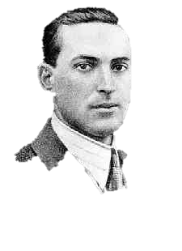


“the unique aspects of human cognition ... were driven by, or even constituted by, social co-operation”
(Moll & Tomasello 2007)
“perception, action, and cognition are grounded in social interaction”
(Sebanz & Knoblich 2008)

Slide 90
challenge
Explain the emergence, in evolution or development, of full-blown theory of mind cognition.
conjecture
The existence of abilities to engage in joint action partially explains how full-blown theory of mind cognition emerges in evolution or development (or both)

Slide 91
challenge
Explain the emergence, in evolution or development, of full-blown theory of mind cognition.
conjecture
The existence of abilities to engage in joint action partially explains how full-blown theory of mind cognition emerges in evolution or development (or both)

Slide 92
tidying up the toys together
(Behne et al 2005)
cooperatively pulling handles in sequence to make a dog-puppet sing
(Brownell et al 2006)
bouncing a ball on a large trampoline together
(Tomasello & Carpenter 2007)
pretending to row a boat together

Slide 93
Goal-directed joint action: an event with two or more agents which, taken as a whole, is directed to a goal.

Slide 94
Goal-directed joint action: an event with two or more agents which, taken as a whole, is directed to a goal.

Slide 95
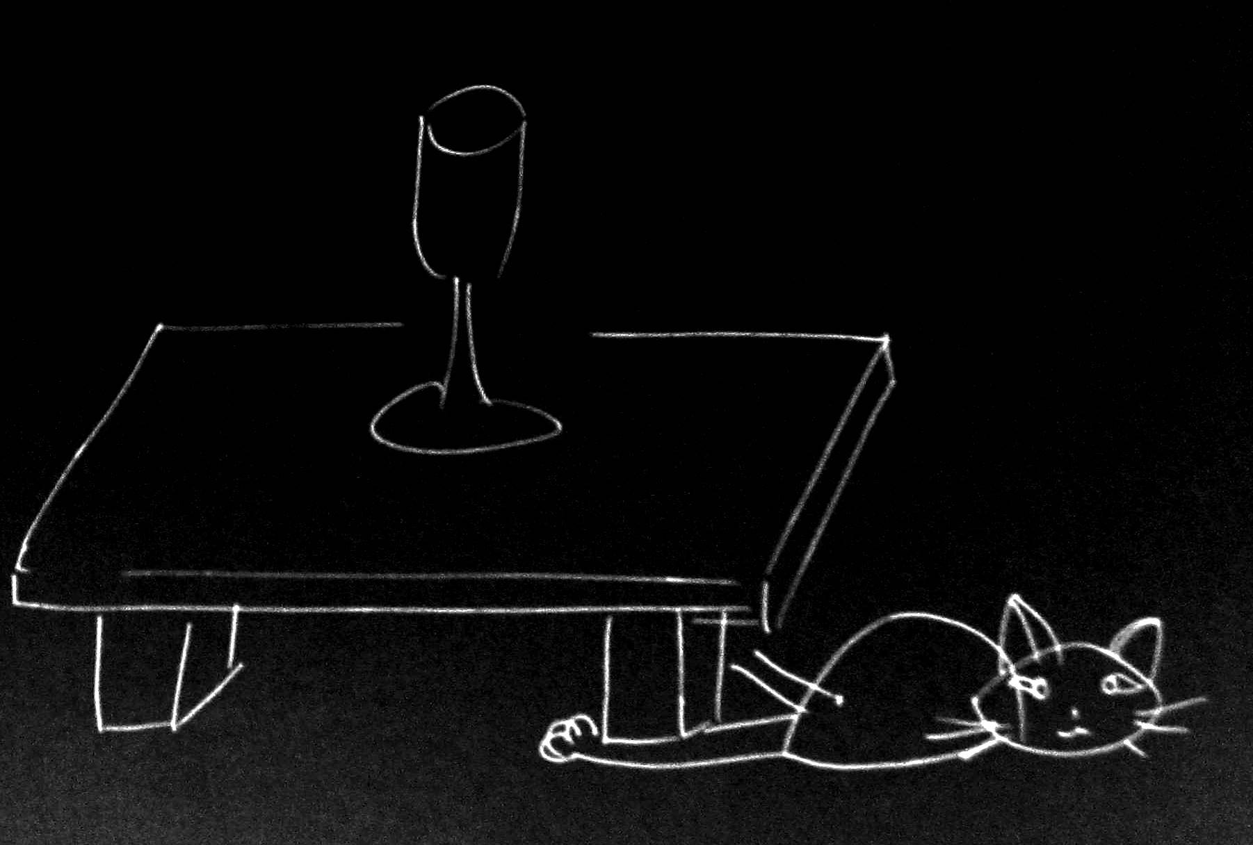
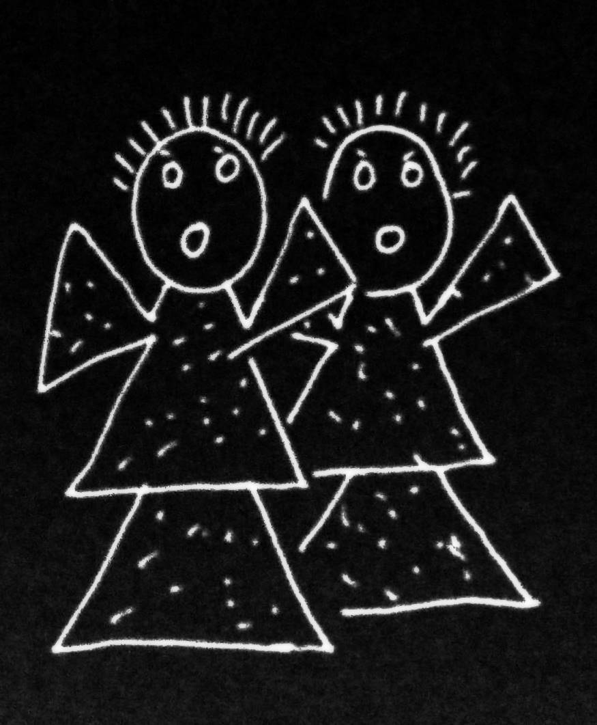
Goal-directed joint action: an event with two or more agents which, taken as a whole, is directed to a goal.

Slide 96
Goal-directed joint action: an event with two or more agents which, taken as a whole, is directed to a goal.

Slide 97
Goal-directed joint action: an event with two or more agents which, taken as a whole, is directed to a goal.
out
out
act
out
act
out

Slide 98
Goal-directed joint action: an event with two or more agents which, taken as a whole, is directed to a goal.
out
out
act
represents
coordinates
out
act
shared intention
out

Slide 99
Goal-directed joint action: an event with two or more agents which, taken as a whole, is directed to a goal.
???
out
out
act
represents
coordinates
out
act
shared intention
out

Slide 100
Goal-directed joint action: an event with two or more agents which, taken as a whole, is directed to a goal.
G is a distributive goal: it is an outcome to which each agent’s actions are individually directed and it is possible that: all actions succeed relative to this outcome.

Slide 101
Goal-directed joint action: an event with two or more agents which, taken as a whole, is directed to a goal.
G is a distributive goal: it is an outcome to which each agent’s actions are individually directed and it is possible that: all actions succeed relative to this outcome.
Nora’s shooting
Fred’s death
Olive’s shooting
Fred’s killing

Slide 102
Goal-directed joint action: an event with two or more agents which, taken as a whole, is directed to a goal.
G is a distributive goal: it is an outcome to which each agent’s actions are individually directed and it is possible that: all actions succeed relative to this outcome.
G is a collective goal
(a) it is a distributive goal;
(b) the actions are coordinated; and
(c) coordination of this type would normally facilitate occurrences of outcomes of this type.

Slide 103
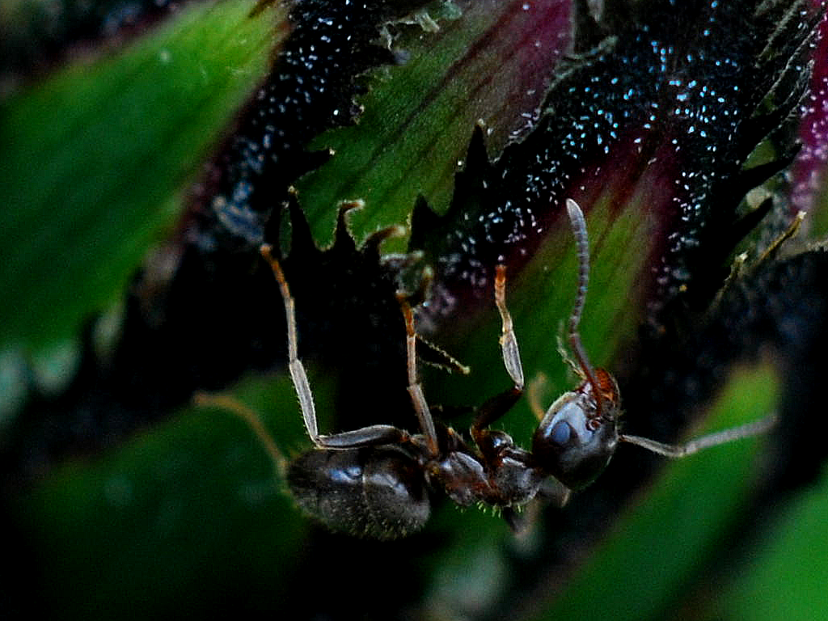

Slide 104
sting
sting
sting
sting
sting
death of fly
sting
sting
sting

Slide 105
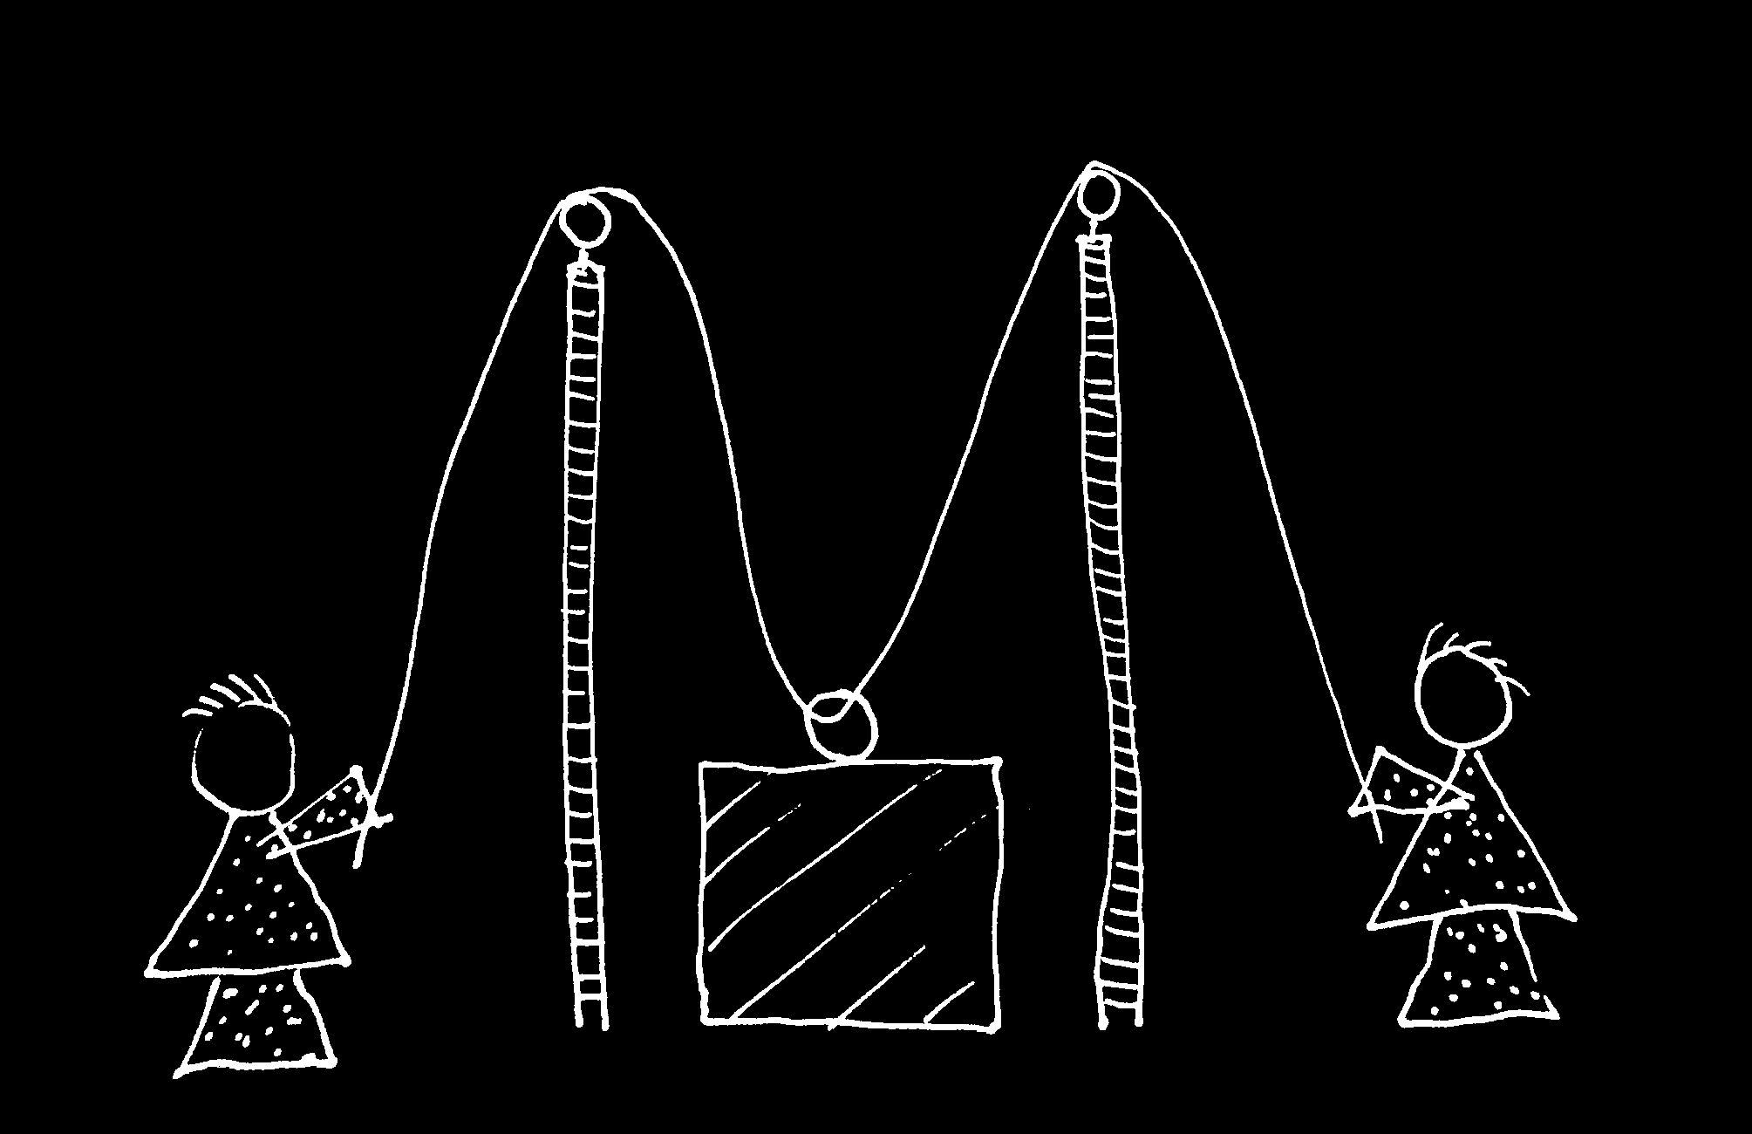

Slide 106
Goal-directed joint action: an event with two or more agents which, taken as a whole, is directed to a goal.
G is a distributive goal: it is an outcome to which each agent’s actions are individually directed and it is possible that: all actions succeed relative to this outcome.
G is a collective goal
(a) it is a distributive goal;
(b) the actions are coordinated; and
(c) coordination of this type would normally facilitate occurrences of outcomes of this type.

Slide 107
Goal-directed joint action: an event with two or more agents which, taken as a whole, is directed to a goal.
G is a distributive goal: it is an outcome to which each agent’s actions are individually directed and it is possible that: all actions succeed relative to this outcome.
G is a shared goal
G is a collective goal
(a) it is a distributive goal;
(b) the actions are coordinated; and
(c) coordination of this type would normally facilitate occurrences of outcomes of this type.
Each agent most wants and expects each of the other agents to perform activities directed to the goal.
Each agent most wants and expects the goal to occur as a common effect of all their goal-directed actions.

Slide 108
Goal-directed joint action: an event with two or more agents which, taken as a whole, is directed to a goal.
G is a distributive goal: it is an outcome to which each agent’s actions are individually directed and it is possible that: all actions succeed relative to this outcome.
G is a shared goal
G is a collective goal
(a) it is a distributive goal;
(b) the actions are coordinated; and
(c) coordination of this type would normally facilitate occurrences of outcomes of this type.
Each agent most wants and expects each of the other agents to perform activities directed to the goal.
Each agent most wants and expects the goal to occur as a common effect of all their goal-directed actions.

Slide 109
Goal-directed joint action: an event with two or more agents which, taken as a whole, is directed to a goal.
G is a distributive goal: it is an outcome to which each agent’s actions are individually directed and it is possible that: all actions succeed relative to this outcome.
G is a shared goal
G is a collective goal
(a) it is a distributive goal;
(b) the actions are coordinated; and
(c) coordination of this type would normally facilitate occurrences of outcomes of this type.
Each agent most wants and expects each of the other agents to perform activities directed to the goal.
Each agent most wants and expects the goal to occur as a common effect of all their goal-directed actions.

Slide 110
Goal-directed joint action: an event with two or more agents which, taken as a whole, is directed to a goal.
G is a distributive goal: it is an outcome to which each agent’s actions are individually directed and it is possible that: all actions succeed relative to this outcome.
G is a shared goal
G is a collective goal
(a) it is a distributive goal;
(b) the actions are coordinated; and
(c) coordination of this type would normally facilitate occurrences of outcomes of this type.
Each agent most wants and expects each of the other agents to perform activities directed to the goal.
Each agent most wants and expects the goal to occur as a common effect of all their goal-directed actions.

Slide 111
Goal-directed joint action: an event with two or more agents which, taken as a whole, is directed to a goal.
etc ...
G is a distributive goal: it is an outcome to which each agent’s actions are individually directed and it is possible that: all actions succeed relative to this outcome.
G is a shared goal
G is a collective goal
(a) it is a distributive goal;
(b) the actions are coordinated; and
(c) coordination of this type would normally facilitate occurrences of outcomes of this type.
Each agent most wants and expects each of the other agents to perform activities directed to the goal.
Each agent most wants and expects the goal to occur as a common effect of all their goal-directed actions.

Slide 112
challenge
Explain the emergence, in evolution or development, of full-blown theory of mind cognition.
conjecture
The existence of abilities to engage in joint action partially explains how full-blown theory of mind cognition emerges in evolution or development (or both)
Notes:
how does that work?

Slide 113
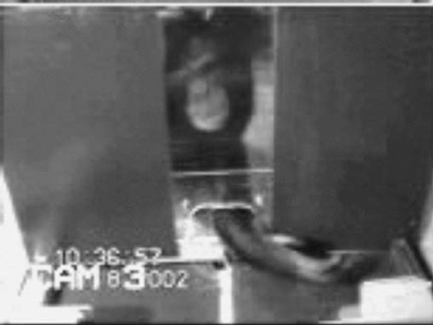
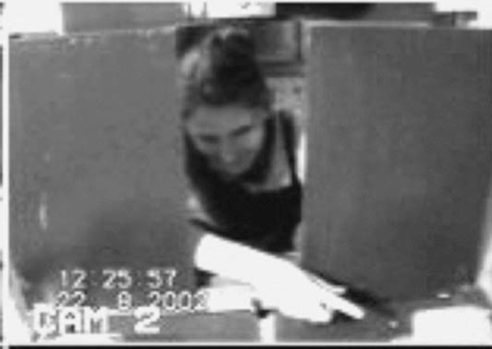
failed reach
point
source: Hare & Tomasello (2004)
Notes:
this illustrates problem of identifying particular goals of action

Slide 114
The problem of opaque means

Slide 115
your-goal-is-my-goal

Slide 116
your-goal-is-my-goal
1. We are about to engage in some joint action* or other
2. I am not about to change my goal.
Therefore:
3. Your actions also will be directed to this goal.
[*in at least the minimal sense associated with distributive goals]

Slide 117
failed reach
point
source: Hare & Tomasello (2004)

Slide 118
failed reach
point
source: Hare & Tomasello (2004)
“to understand pointing, the subject needs to understand more than the individual goal-directed behaviour. She needs to understand that ... the other attempts to communicate to her ... and ... the communicative intention behind the gesture”
(Moll & Tomsello 2007)

Slide 119
failed reach
point
source: Hare & Tomasello (2004)
“to understand pointing, the subject needs to understand more than the individual goal-directed behaviour. She needs to understand that ... the other attempts to communicate to her ... and ... the communicative intention behind the gesture”
(Moll & Tomsello 2007)

Slide 120
challenge
Explain the emergence, in evolution or development, of full-blown theory of mind cognition.
conjecture
The existence of abilities to engage in joint action partially explains how full-blown theory of mind cognition emerges in evolution or development (or both)

Slide 121

minimal theory of mind cognition
joint action (ability to share goals)
understanding communicative intent
other stuff
communication by language
other stuff
sophisticated theory of mind cognition

